Slide 1

Bank CRM Data Analysis
By S SHABIN
DS November 2023

Slide 2

Introduction
Banks have existed since at least the 14th century. It is a financial institution that is licensed to accept checking and savings deposits and make loans.
Customer relationship management (CRM) is a necessity in any customer-focused industry. In banking it helps banks manage customers and better understand their needs in order to provide the right solutions, quickly.
Customer Relationship Management has become inevitable for growth and profitability of Banks in present scenario marked by rising competition, technological advancement and empowered customers.

Slide 3

Problem Statement
You are an analytical CRM (Customer Relationship Management) specialist hired by a bank to extract meaningful insights from various customer-related datasets. The bank aims to reduce customer churn, improve service delivery, and enhance customer satisfaction. They have provided you with datasets including customer demographics, transaction details, customer exit information, and active customer profiles.

Slide 4

Objectives
Determine the key factors contributing to customer churn
Identify profitable customer segments and target them with tailored services

Slide 5

Key Factors
1
Customers churned and churning rates
2
Customer Behavior Indicator (Active or Non Active)
3
Economic Indicators ( salary, balance ,credit score)
4
Demographic Indicators(Age, Gender)
5
Geographic indicators

Slide 6

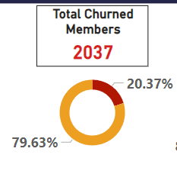
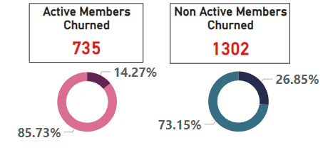
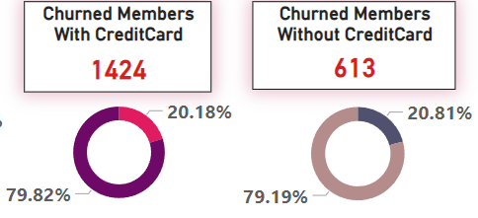
Behavior Based Churn Analysis
Overall Customer churning has been predominant with 2037 customers churned at a churning rate of 20.37% .
The churning among Non- Active members are predominantly higher than that of active members . The non active members churned are 1302 at a rate 26.85% whereas there are 735 churned members among active members at a churn rate of 14.27%.
To understand churning among customers with affinity towards particular products, credit card availability was considered. customer churned with credit cards (1424 at 2018%) were predominantly higher than those without cards(613 at 20.81%).

Slide 7
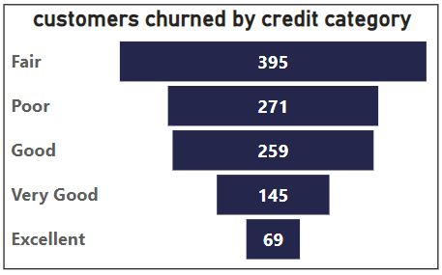
Economic Indicators Based Analysis
Credit card score is one of the major economic stability indicator available today. On analysis ,the highest number of churned people are in the “Fair” category with 395 customers churned.

Slide 8
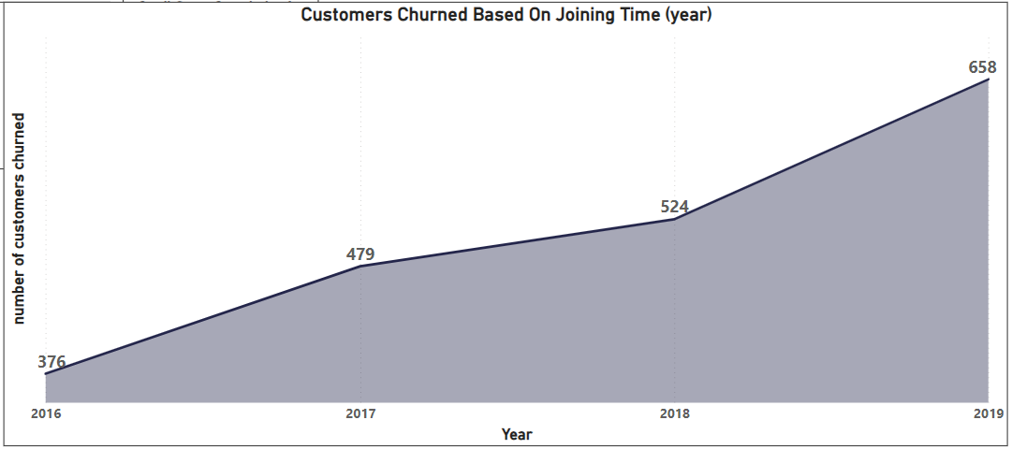
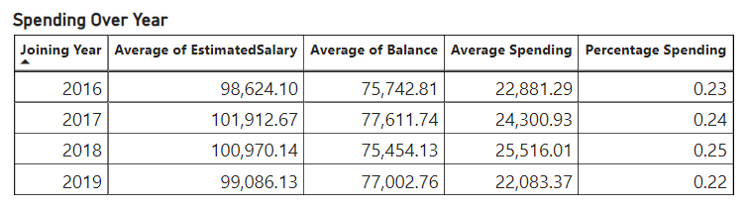
Joining Year Based Churn Analysis
Based on joining year customers cane be categorized into long term and new term customer. The customer's loyalty is quantified by analyzing churn data .
It shows new customers have higher tendency to churn 2019 (658) when compared to long term customers 2016 (376).
Spending percentage shows that new customers new customer spend less compared to long-term customers.

Slide 9
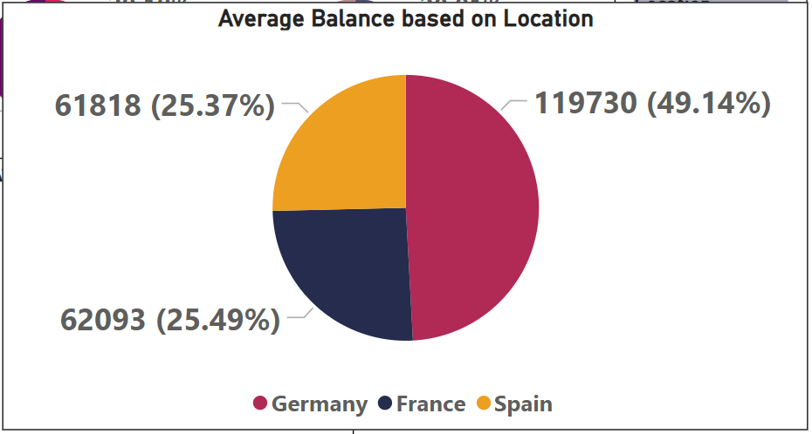
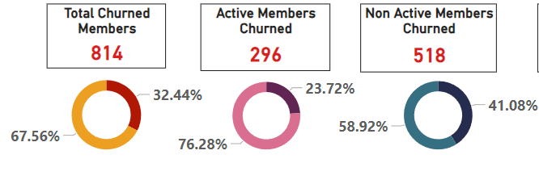
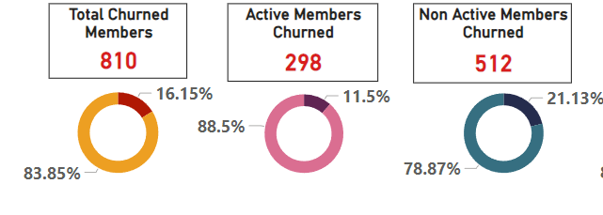
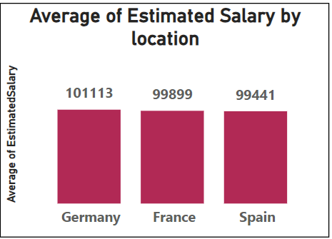
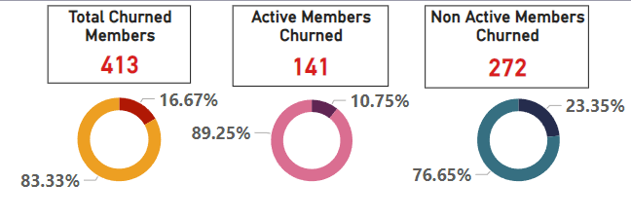
Geographic Location Based Analysis
Germany
There are a various location specific factors influencing the customer -bank relation
From the analysis Germany has the highest number of customers churning (814 customers).
On analyzing economic factors Germany has the highest average salary(101113) and average balance(119730)
France
Spain

Slide 10
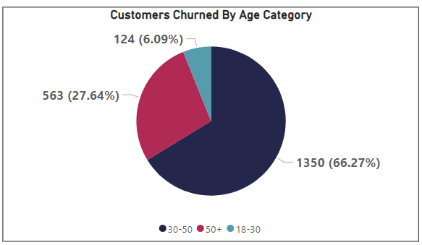
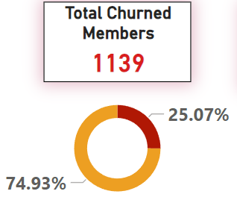
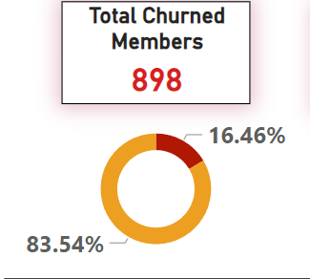
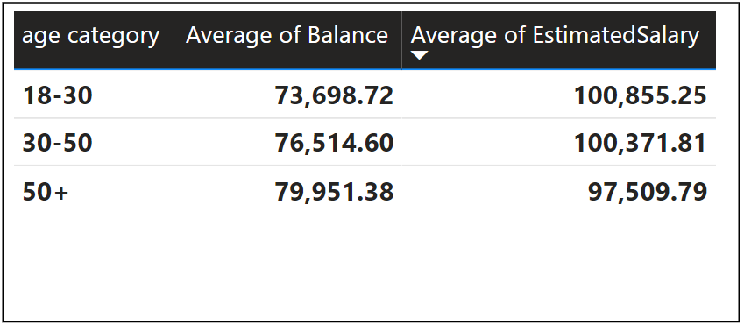
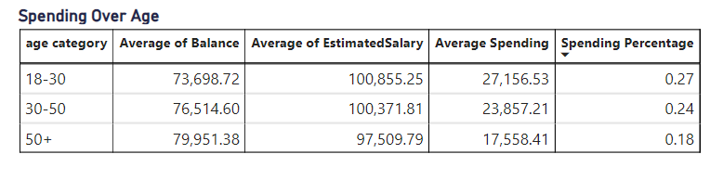
Demography Based Analysis
Female
Gender based analysis showed that Female customers are churning more than Male customers. There are 1139 female customers (25.07%) who churned and 898 male customers(16.46%) who churned.
Age group-based analysis showed that the highest number of customers churned are from the age group of 30-50 years of age with 1350 customers churned at a churn rate of 66.27%.
Age group of 30-50 are the customers with highest financial risk as they have second highest average salary and average balance and a spending rate of 24%.
Male

Slide 11
Conclusion
Churning is predominant among non active members than that of active members, which means customer engagement is an important factor.
Number of customers churned with credit card is more than those without creditcard,this means that products like credit cards are not exciting enough .
New customers have higher tendency to churn than long term customers.
Credit score category “Fair” has highest churning
.
Germany is the location were most number of people are churning, this means there are some location specific factors which needs to be addressed.
On demographic basis males are more prone to churning than females ,also people in the age group of 30-50 are most unsatisfied with bank.

Slide 12

Suggestions To Reduce
Customer Churn
Prioritize proactive customer service.
Offer incentives
Use micro surveys to determine the dissatisfaction among customers
Define a roadmap for customers based on risk factors .
Include location specific products and policies
Stay competitive

Slide 13

Report

Slide 14
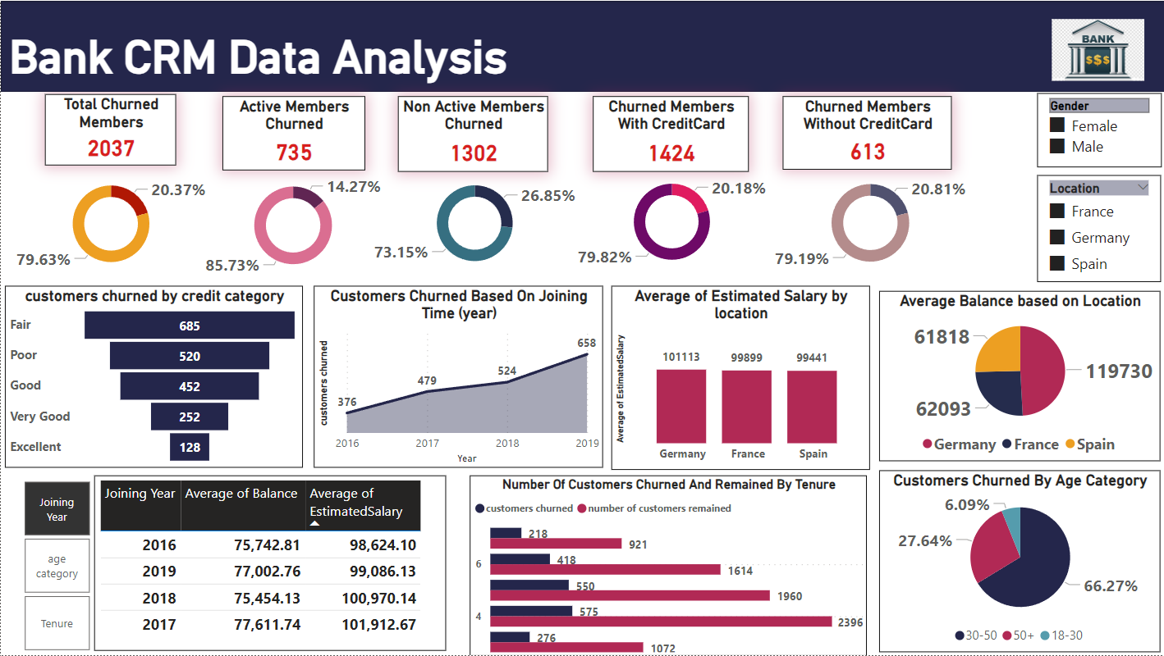

Slide 15
Thank you

